Slide 1

Welcome
to
Jeopardy!

Slide 2
Geometry Games
Equations and Expressions
Probability Problems and Daily Data
Excellent Exponents, Roots, and Notation
I’m Into Integers
Mixed Bag
Round 2
$100
$100
$100
$100
$100
$100
Final Jeopardy
$200
$200
$200
$200
$200
$200
$300
$300
$300
$300
$300
$300
$400
$400
$400
$400
$400
$400
$500
$500
$500
$500
$500
$500

Slide 3
$100
What is the perimeter and area of a square with side length of 4 cm?

Slide 4
$100
16 cm

Slide 5
$200
A circle has a diameter of 10 inches. What is the circumference of the circle?

Slide 6
$200
10π squared inches
Scores

Slide 7
$300
The diameter of a circle is 6 meters. What is the area of the circle?

Slide 8
$300
9π squared meters
Scores

Slide 9
$400
A right triangle has two legs of 5 cm and 12 cm. What is the length of the hypotenuse?

Slide 10
$400
13 cm
Scores

Slide 11
$500
A circle has an area of 25π squared yards. What is the radius of the circle?

Slide 12
$500
5 cm
Scores

Slide 13
$100
I have two markers. Josh has three times as many markers as I do. How many markers does Josh have?

Slide 14
$100
6 markers
Scores

Slide 15

$200
Find w if $\frac{w}{4}=−7$

Slide 16
$200
w = -28
Scores

Slide 17

$300
Find x if $2x+3=13$

Slide 18
$300
x = 5
Scores

Slide 19
Daily
Double

Slide 20
$400
George has 3 rabbits. If Lennie has twice as many rabbits as George does, and Slim has two fewer rabbits than Lennie does, how many rabbits does Slim have?

Slide 21
$400
4 rabbits
Scores

Slide 22
$500
Evaluate 3 + 6 x (5 + 4) ÷ 3 - 7 using the order of operations.

Slide 23
$500
14
Scores

Slide 24
$100
I have three red markers and two blue markers in a bag. What is the probability I pick a blue marker from the bag randomly?

Slide 25

$100
$$\frac{2}{5}$$
Scores

Slide 26
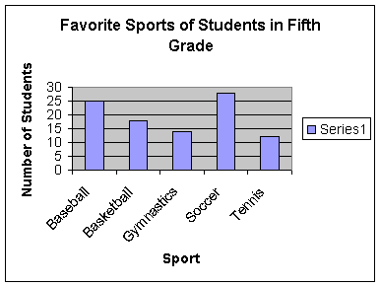
$200
Which is the favorite sports of students in the fifth grade?

Slide 27
$200
Soccer
Scores

Slide 28
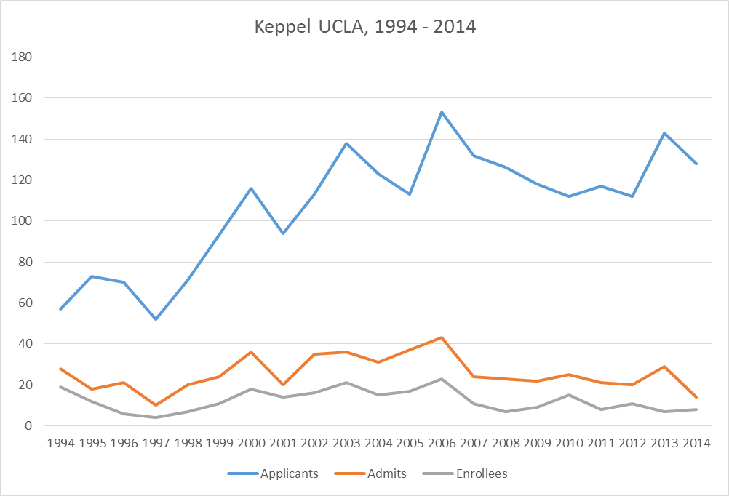
$300

Slide 29
$300
Increasing
Scores

Slide 30
$400
Remember that game when I rolled the two dice and added the numbers? Which sum is most likely to occur?

Slide 31
$400
7
Scores

Slide 32
$500
Manny has two blue soccer balls, three red soccer balls, and four green soccer balls in a bag. He takes a green ball from the bag and kicks it away. Then, he reaches into the bag for another ball. What is the probability that he gets a green ball?

Slide 33

$500
$$\frac{3}{8}$$
Scores

Slide 34
$100
What is 3³?

Slide 35
$100
27
Scores

Slide 36
$200
Express 24,000,000 in scientific notation.

Slide 37
$200
2.4×10⁷
Scores

Slide 38
$300
What is √225?

Slide 39
$300
15
Scores

Slide 40
$400
What is 4⁵×4³? Leave the answer in exponential form.

Slide 41
$400
4⁸
Scores

Slide 42

$500
Write the following in exponential form: $\sqrt[4]{xy}$

Slide 43

$500
$${(xy)}^{\frac{1}{4}}$$
Scores

Slide 44
$100
4-(-3)

Slide 45
$100
7
Scores

Slide 46
$200
-3+(-4)-(-3)

Slide 47
$200
-4
Scores

Slide 48
$300
2+(-3)×4

Slide 49
$300
-10
Scores

Slide 50
$400
(-4)+(-3)-(-10)+5

Slide 51
$400
8
Scores

Slide 52
$500
-9×4/-3

Slide 53
$500
12
Scores

Slide 54

$100
If a☺b = $\frac{a^{2}+b^{2}}{a}$, what is a☺b if a = 5 and b=10?

Slide 55
$100
25
Scores

Slide 56
$200
Is -2³ positive or negative?

Slide 57
$200
negative
Scores

Slide 58
$300
I flip a coin. What is the probability that I get a heads?

Slide 59
$300
1/2
Scores

Slide 60
$400
I have three times as many markers as Laura. Laura has six markers. How many markers do I have?

Slide 61
$400
18 markers
Scores

Slide 62
$500
If one side of a right triangle is 3 meters and the hypotenuse is 5 meters, how long is the other side?

Slide 63
$500
4 meters
Scores

Slide 64
Final
Jeopardy
Logarithms
Final Jeopardy Question
Scores

Slide 65

$${What is log}_{2}{32}?$$

Slide 66
5
Scores

